Slide 1
MODULES
AIRPORT
FLIGHT
FLIGHT SCHEDULE
CREW
FLIGHT CREW
ADMIN LOGIN ( OPTIONAL )

Slide 2
AIRPORT
This module will store the details about the Airport such as :
Airport Name
Airport ID
Location
Runways
Airport _ID | Airport_Name | Location | Runways
MAA | Kamaraj Airport | Chennai | 6
BOM | Chhatrapati Shivaji International Airport | Mumbai | 8

Slide 3
FLIGHT MASTER
This module will be storing some basic fixed properties of the flights such as :
Flight ID
Airline Name
Flight Type
Capacity
Flight_ID | Airline | Class Type | Capacity
IG-120 | GO INDIGO | Economy | 150
AI-063 | AIR INDIA | Business | 80

Slide 4
FLIGHT SCHEDULE
Flight Number / ID
Date
Departure Time
Arrival Time
Source
Destination
Number Of Passengers
Status
Remarks
F_ID | Date | D-Time | A-Time | Source | Destination | Passg. | Status | Remarks
IG-120
AI-063

Slide 5
CREW MASTER
This module will be storing some common characteristics of the crew members such as :
Member ID
Member Name
Designation
Mobile Number
Email
Member_ID | Name | Designation | Mobile | Email
AD – 01 | Raj Singh | Boarding manager | 95844623689 | raj.singh@yahoo.in

Slide 6
FLIGHT CREW
This module will be storing the info about the flight crew members with their current status :
Flight Number / ID
Member ID
Departure Airport
Departure Date
Status
Flight_ID | Member_ID | Source | Date | Status

Slide 7
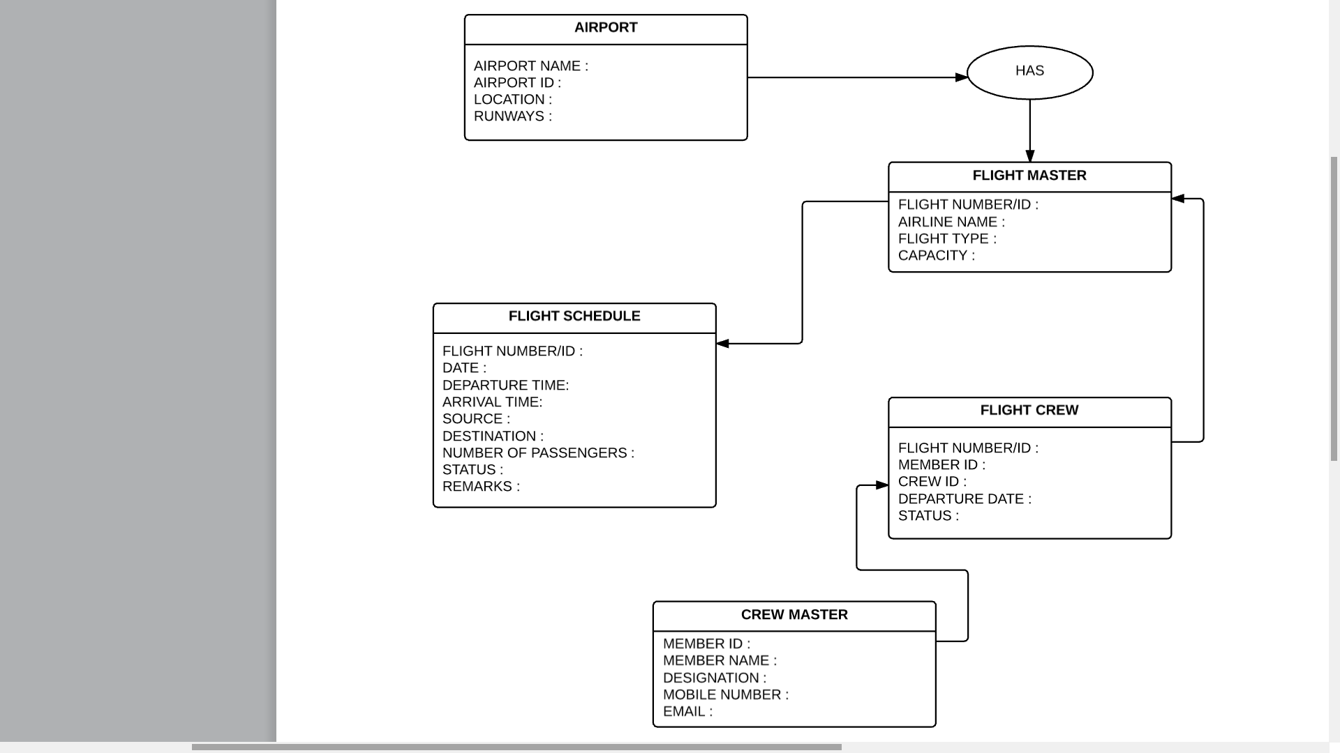

Slide 8
